Slide 1
UX/UI Practicum
Our seating chart generator
Made by Adrian Casares, Ryan Kellar, Nishtha Verma, and Zachary Sunga

Slide 2
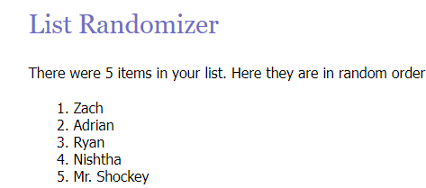

Product Overview
We built a seating chart generator that LASA teachers could use to save time
After talking to Dr. Pinkston, one of the most common issues that she (along with many other LASA teachers) had is that there isn’t a good tool to build a seating chart for their classes
Notes:
Ryan

Slide 3
Product Overview
Instead of forcing the teachers to do more work to make the seating charts, our app seeks to minimize the amount of interaction between the teacher and the data/list of students they input.
Teachers want to filter students based on certain criteria like separation, pairing, and preferential seating, whether accommodation-based or not.
Unfortunately, this results in a lot of work on the teachers behalf because they need to manually swap two students to fulfill these filters.
Notes:
Ryan

Slide 4
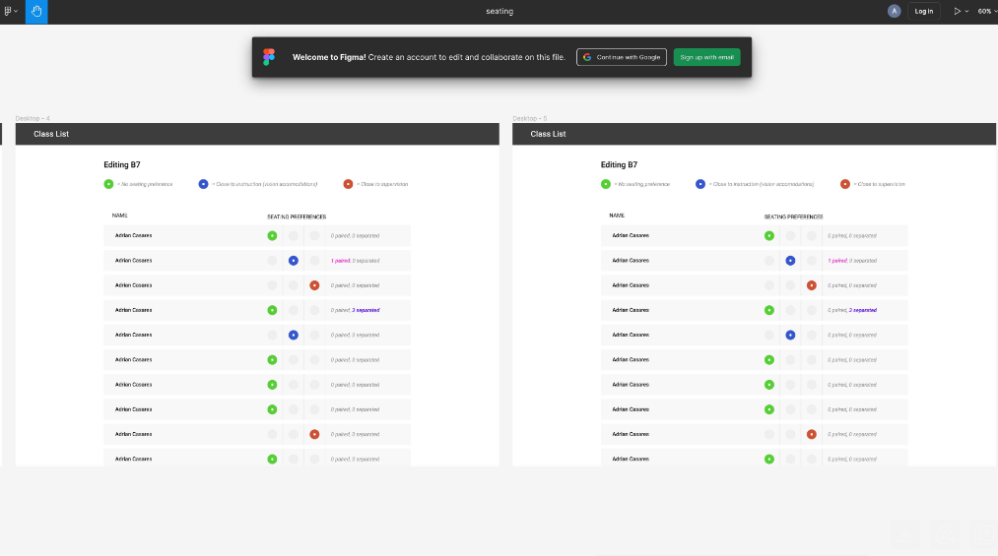
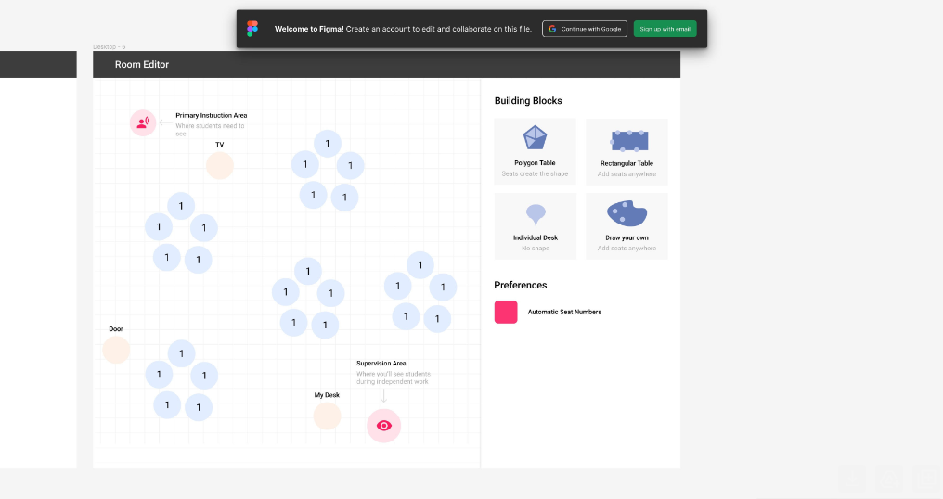
Product Features
Our main idea was to maximize the amount of filtering the teacher could include when building the student seat positions
Offers filters based on student needs
Accounting for students who have specific accommodations
Notes:
Ryan

Slide 5
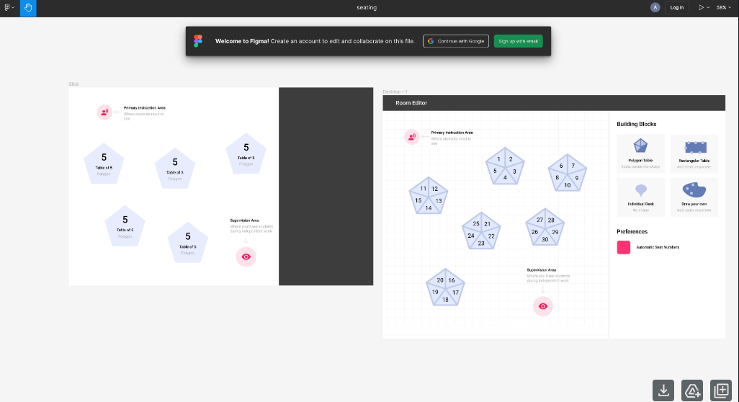
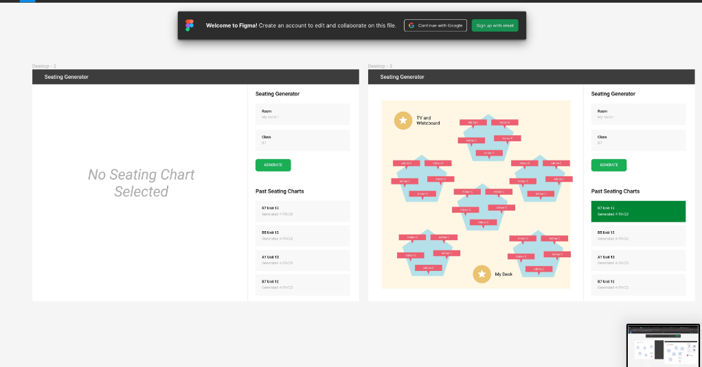
Product Features
Teachers wanted to be able to easily change saved setups of either their room or the students
Different configurations for room setup
Saved previous and current student seat positions
Notes:
Ryan

Slide 6


Project Implementation
Notes:
Next JS provides a front-end framework for React: essentially you can write code intended for the front-end and Next JS will compile it to server-side code that can be used by react.
React handles the view layer of the Model-View-Control
Talk about if you had a button that changed a value every time you clicked it, but the webpage is static w/o React so the value wouldn’t update/re-render.

Slide 7
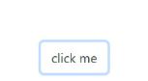
Project Implementation
Static HTML
React
Click Counter: 3
Click Counter:
3
4
Stored Clicks:
3
Stored Clicks:
3
4
4
Notes:
Next JS provides a front-end framework for React: essentially you can write code intended for the front-end and Next JS will compile it to server-side code that can be used by react.
React handles the view layer of the Model-View-Control
Talk about if you had a button that changed a value every time you clicked it, but the webpage is static w/o React so the value wouldn’t update/re-render.

Slide 8


Project Implementation
Notes:
We used TailwindCSS instead of bootstrap because the classes offered by tailwind were more dynamic and not as rigid as bootstrap, which allowed for more customization of our website. We also used Dexie JS for our database because it would allow us to prioritize the appearance of our web page for users and provided an easy to use interface for the database.

Slide 9
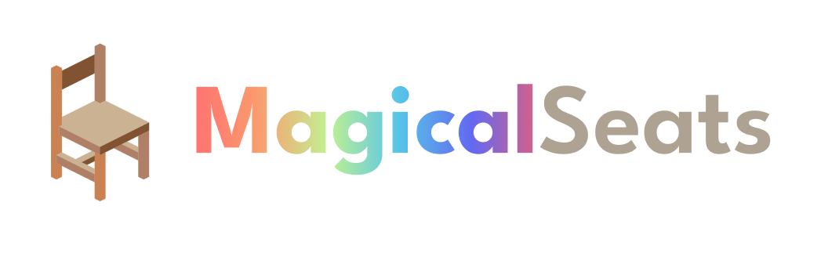
Project
demo

Slide 10

Empathize
Before initially getting the idea from a brief interview, we went in for 3 more detailed interviews.
Focus groups → macro trends
Interviews → individual needs

Slide 11

Empathize
Initial idea was NOT the same as empathizing with your users
Email interview used to generate ideas is a preliminary step.

Slide 12
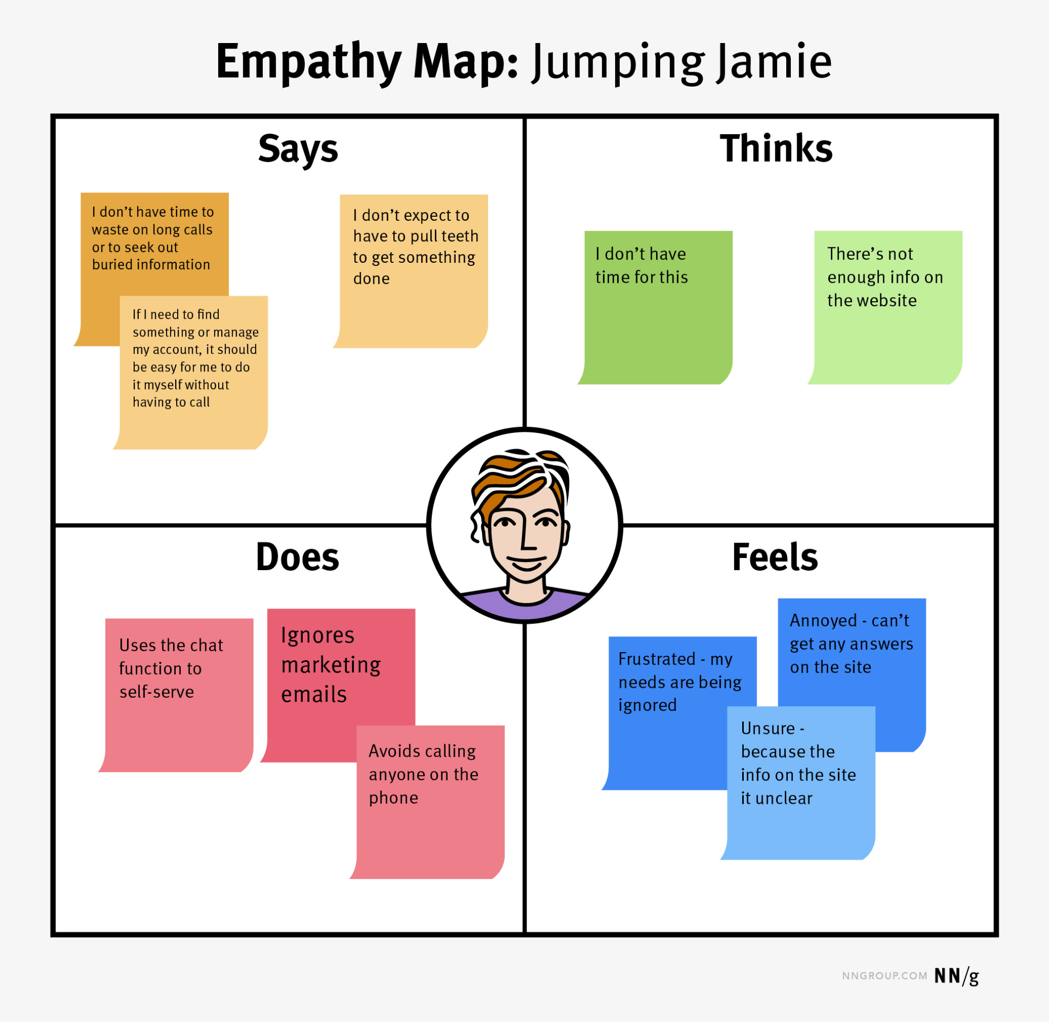
Empathize Methodology
Focus on what teachers are already doing since classroom procedures tend to be pretty solid

Slide 13


Empathize Conclusion
Seating charts play a ton of different roles in the classroom

Slide 14
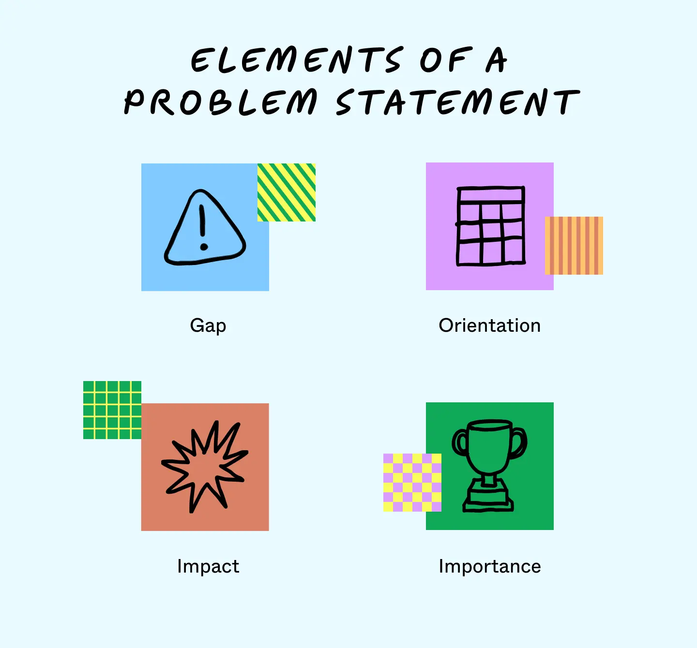
Define
Existing tools are expensive, complex, and lack important features

Slide 15
Define
Tools in the classroom don’t integrate seamlessly with real life

Slide 16
Define
Teachers will spend less time on their seating charts; Seating charts are a part of lesson planning for many teachers.

Slide 17
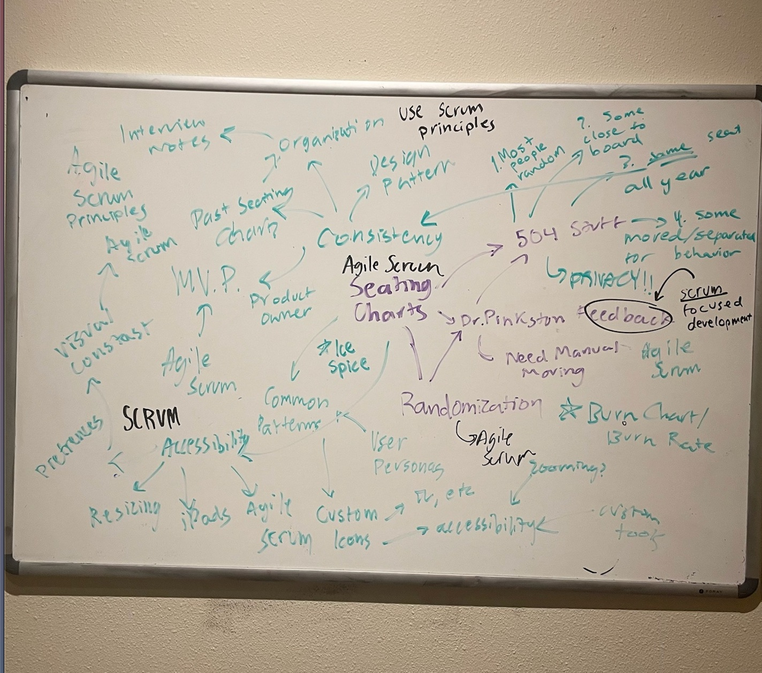
Ideate

Slide 18
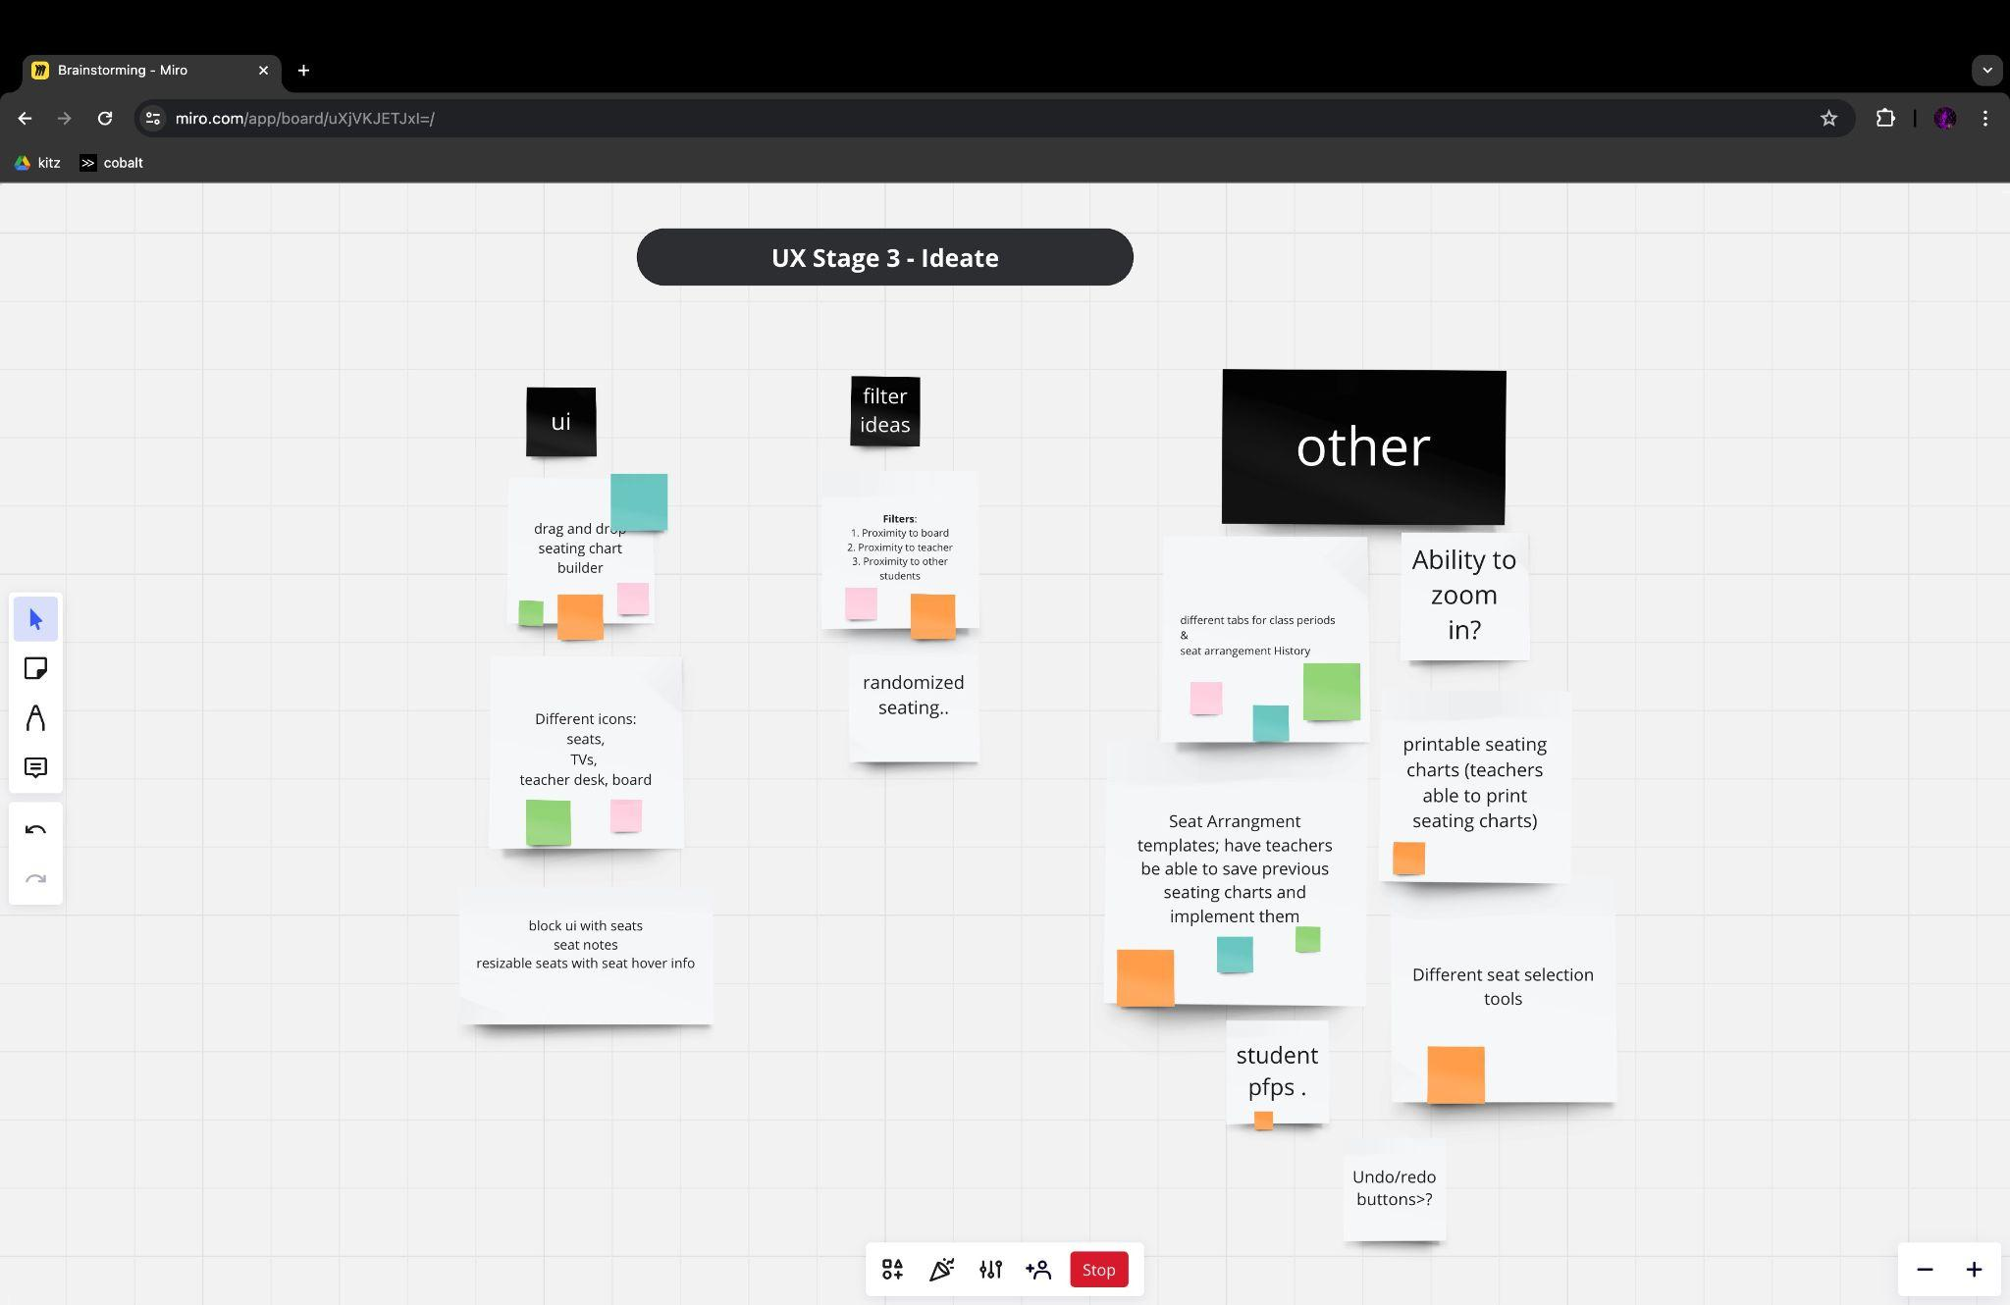
Ideate

Slide 19
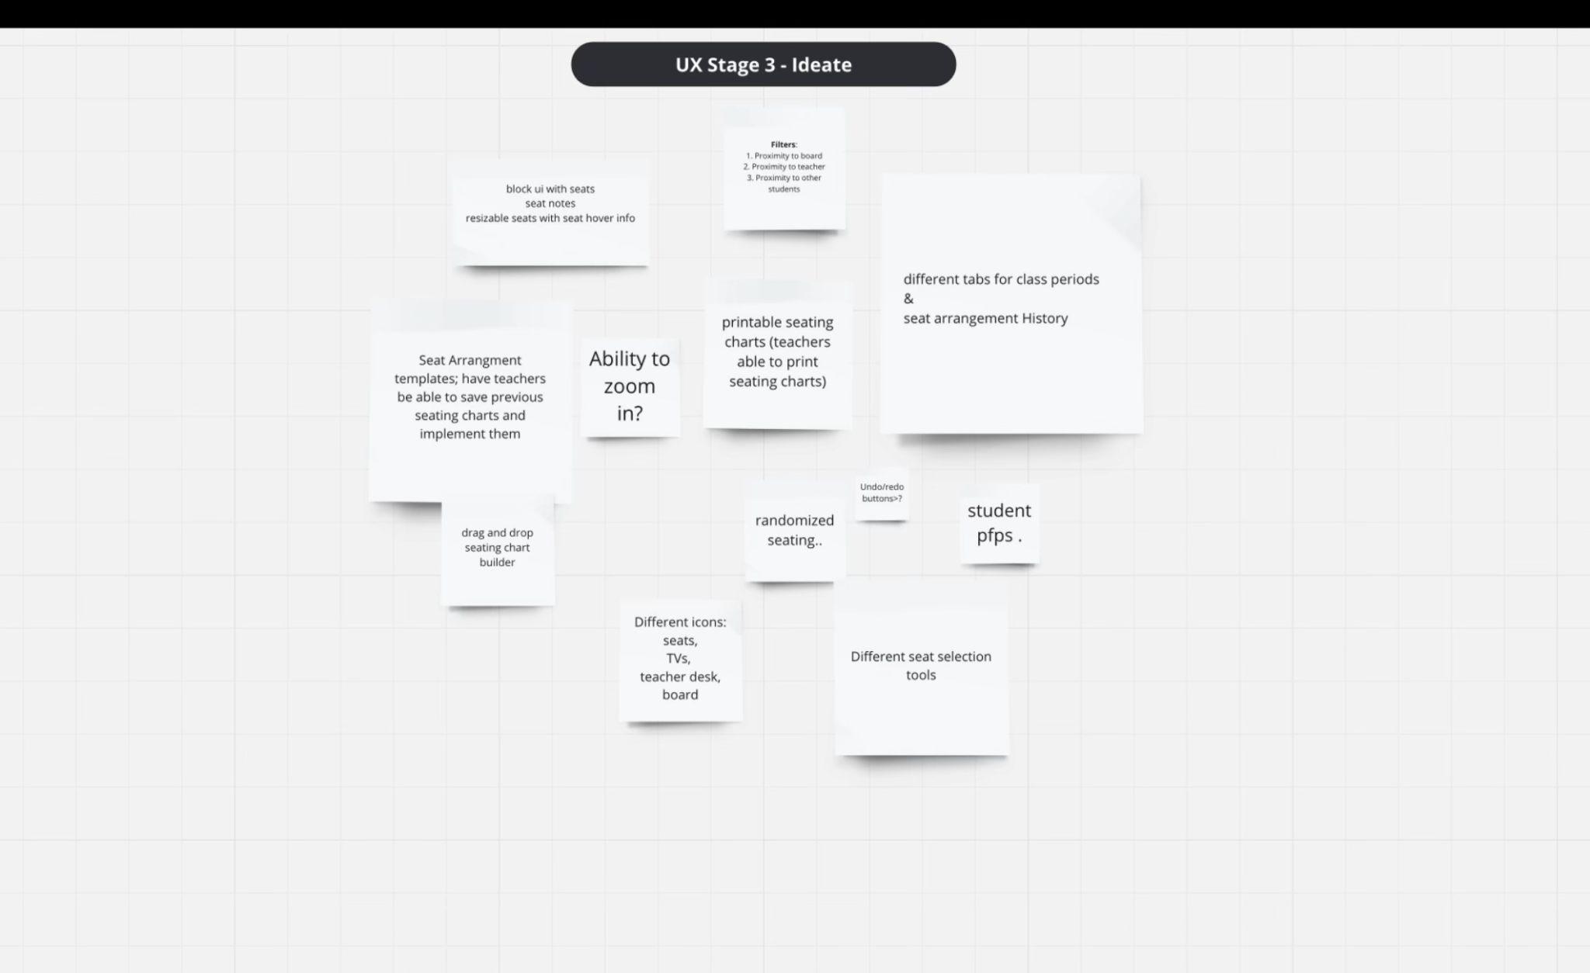
Ideate

Slide 20
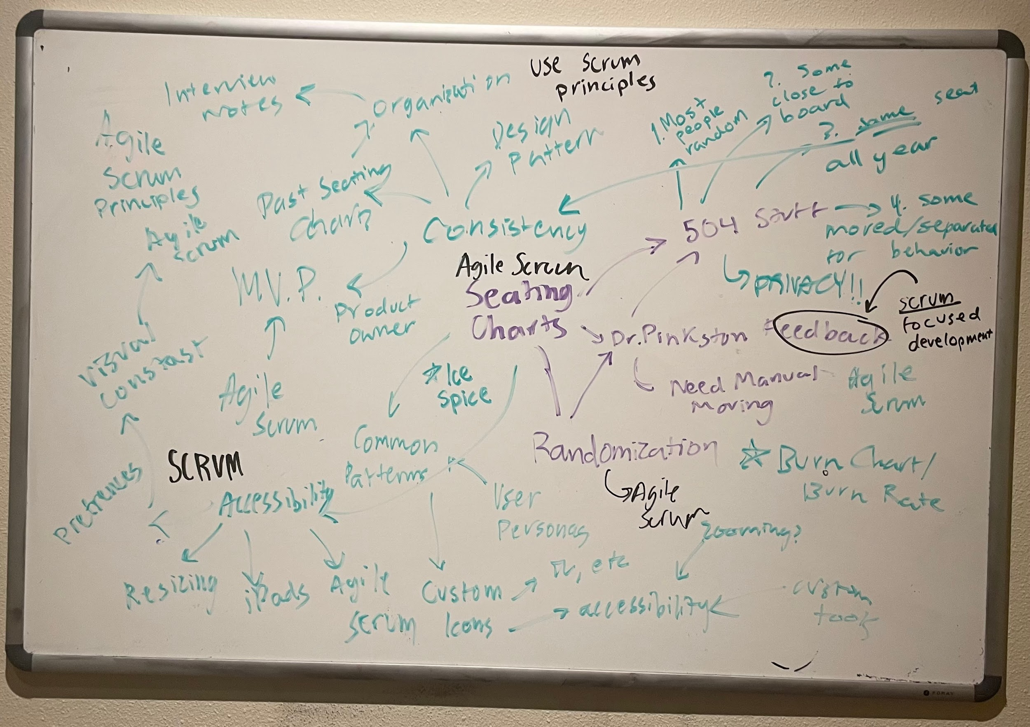
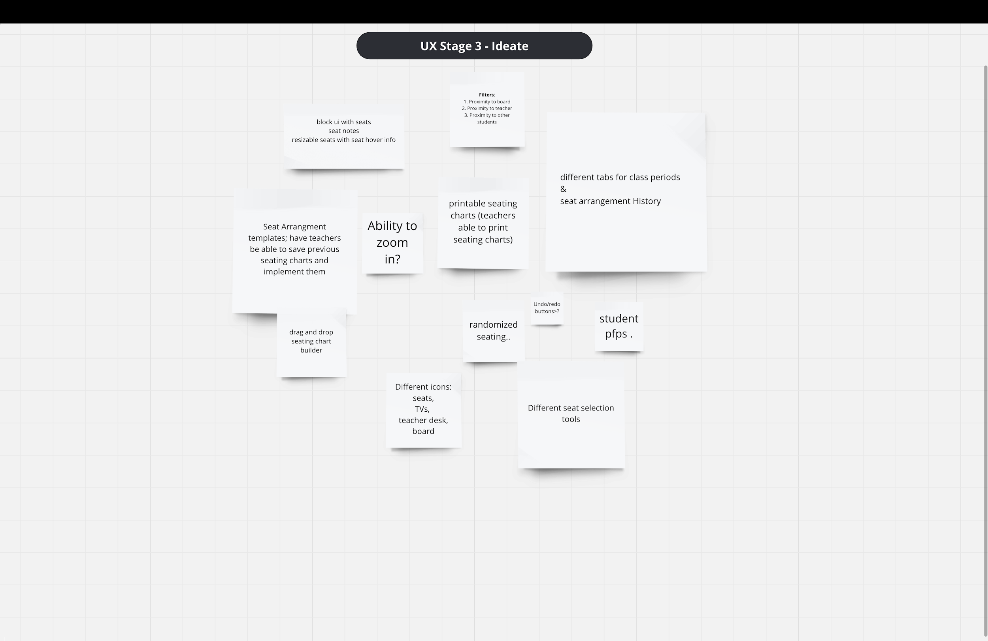

Ideate
Our initial ideas:
Drag and drop seating chart builder
for ease of use and flexibility
Different icons/building blocks
Keep it simple, stupid
scatter
gather
Notes:
used miro for session
we made sure to promote realistic ideas that were actually doable.

Slide 21
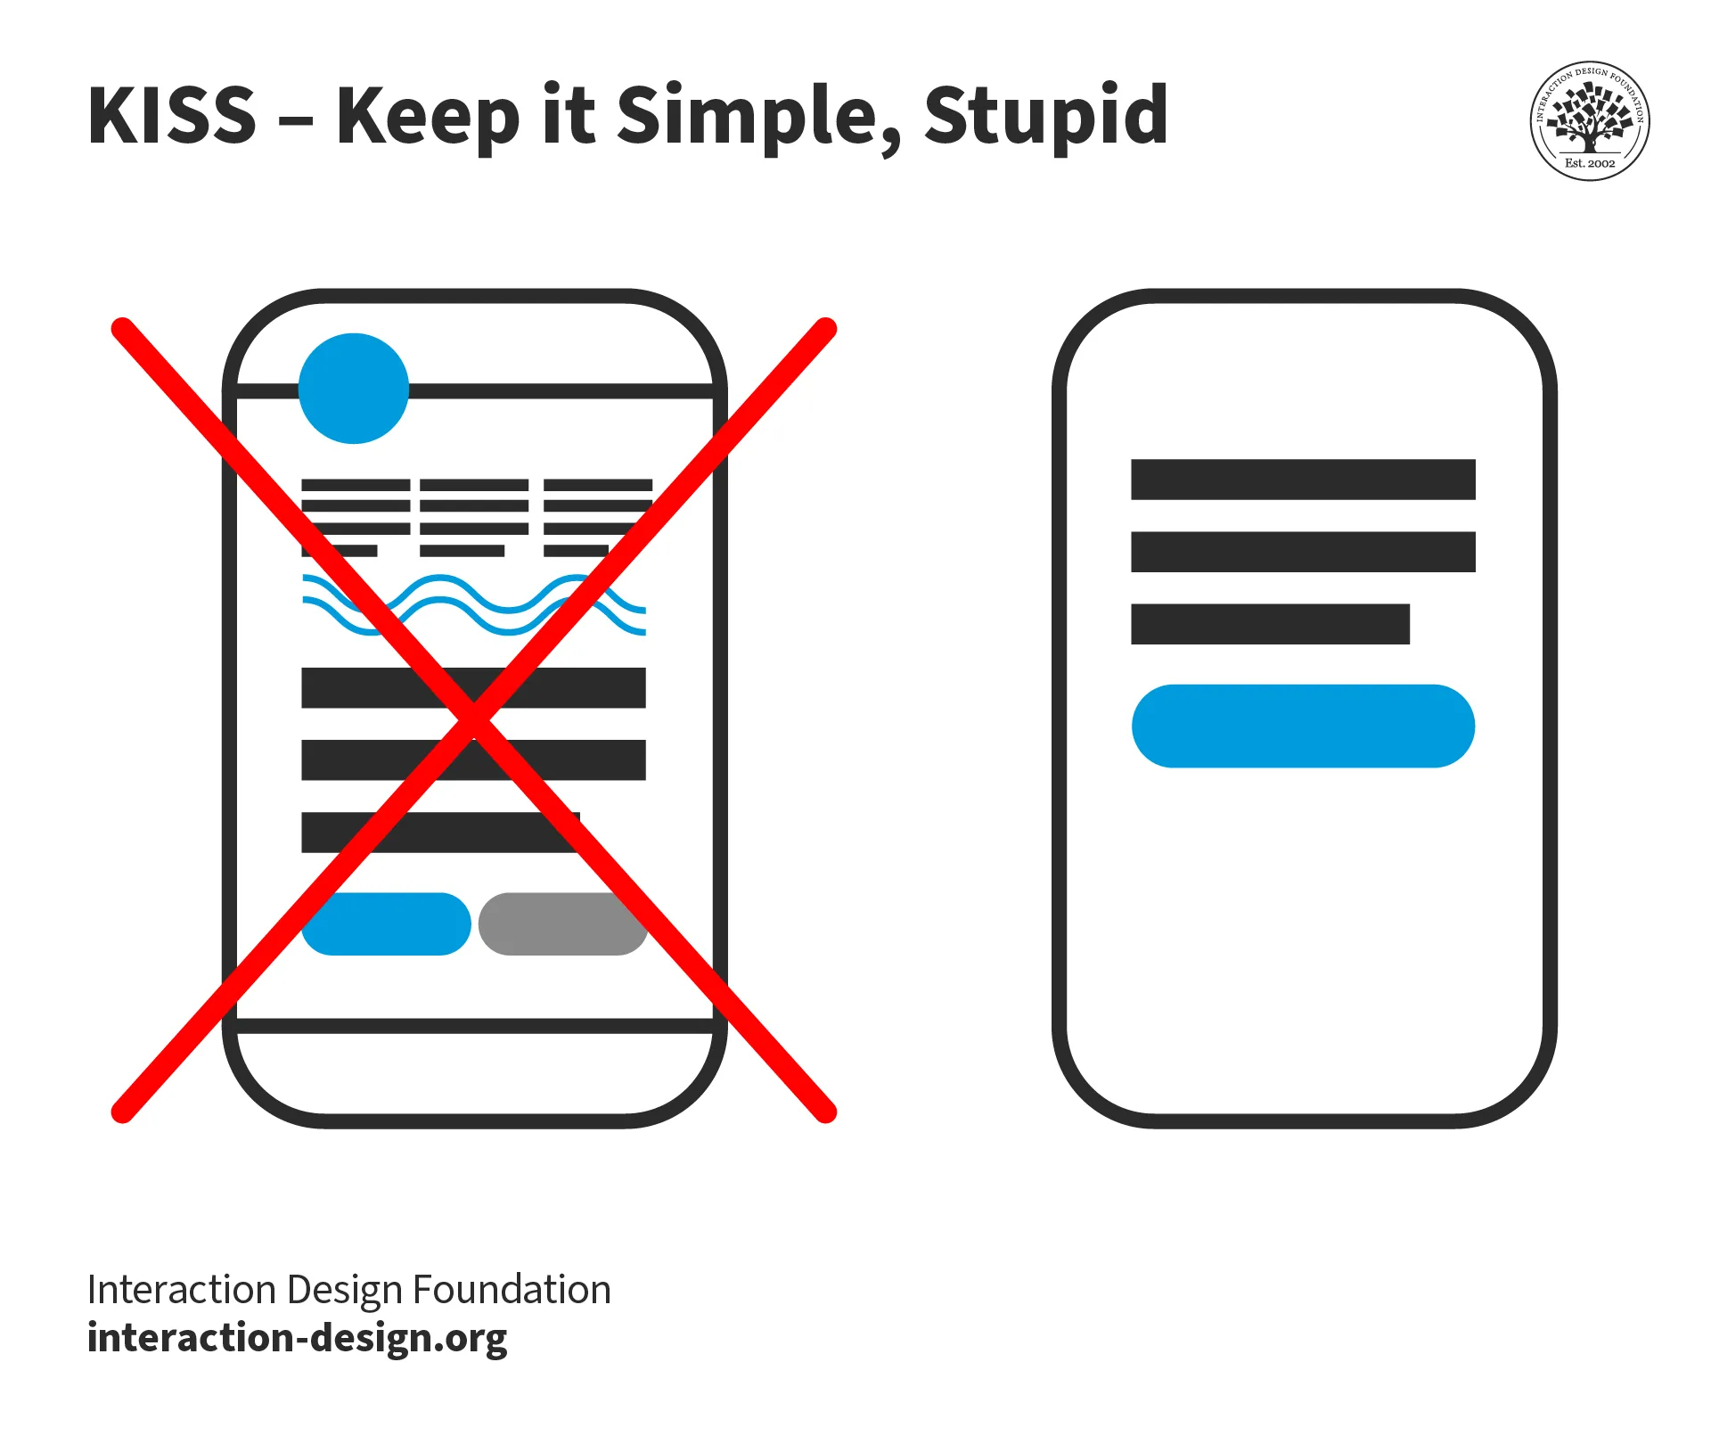

Ideate w/ Agile Scrum
Notes:
used miro for session
we made sure to promote realistic ideas that were actually doable.

Slide 22
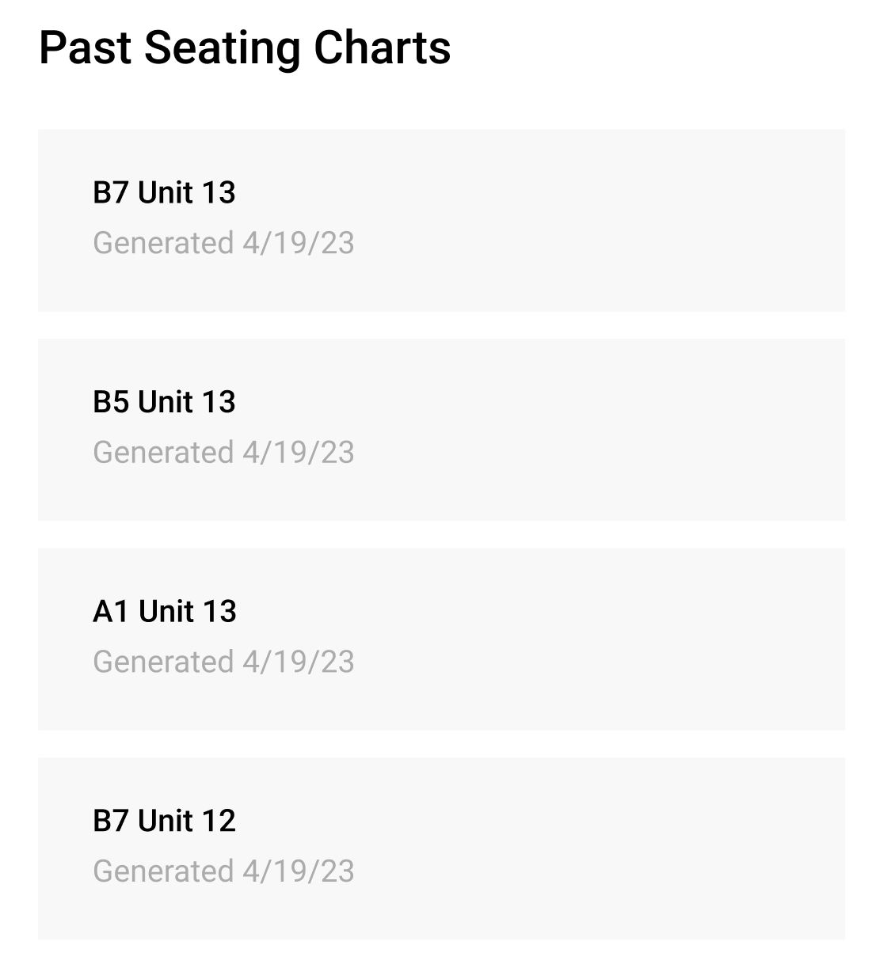
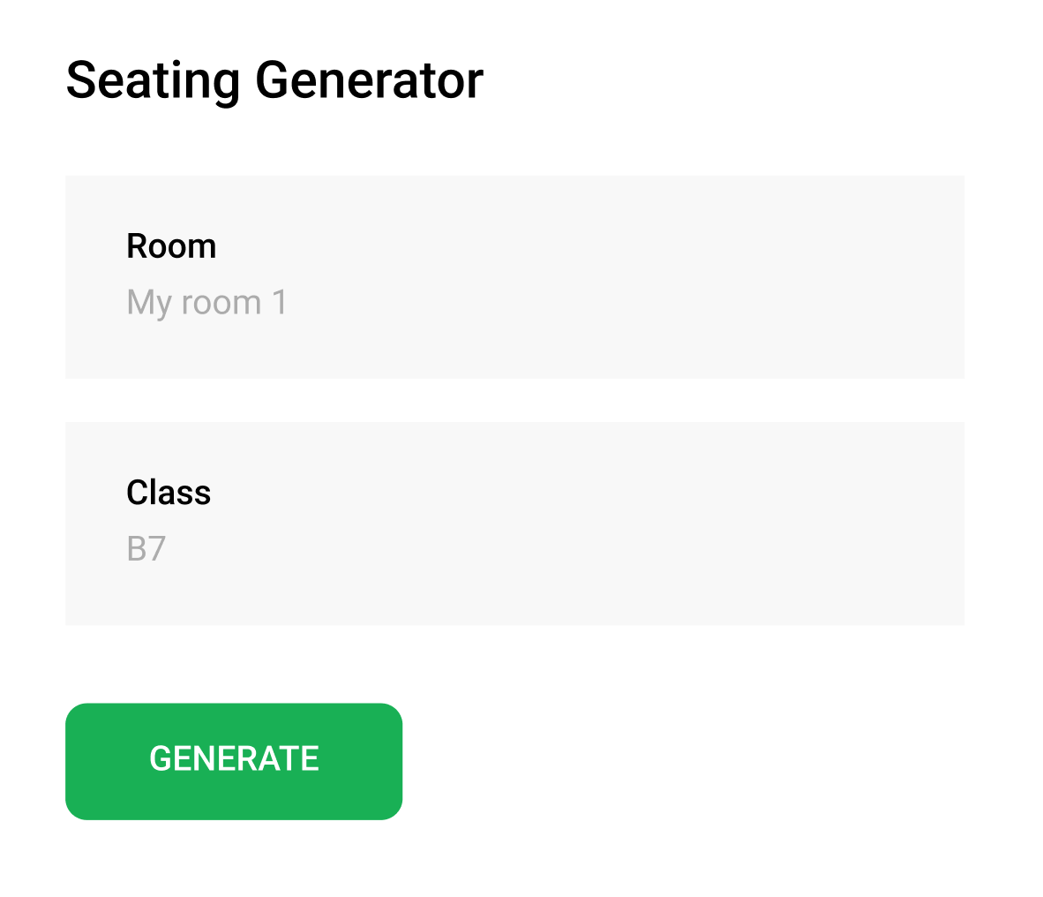
Prototype: the building blocks

Slide 23
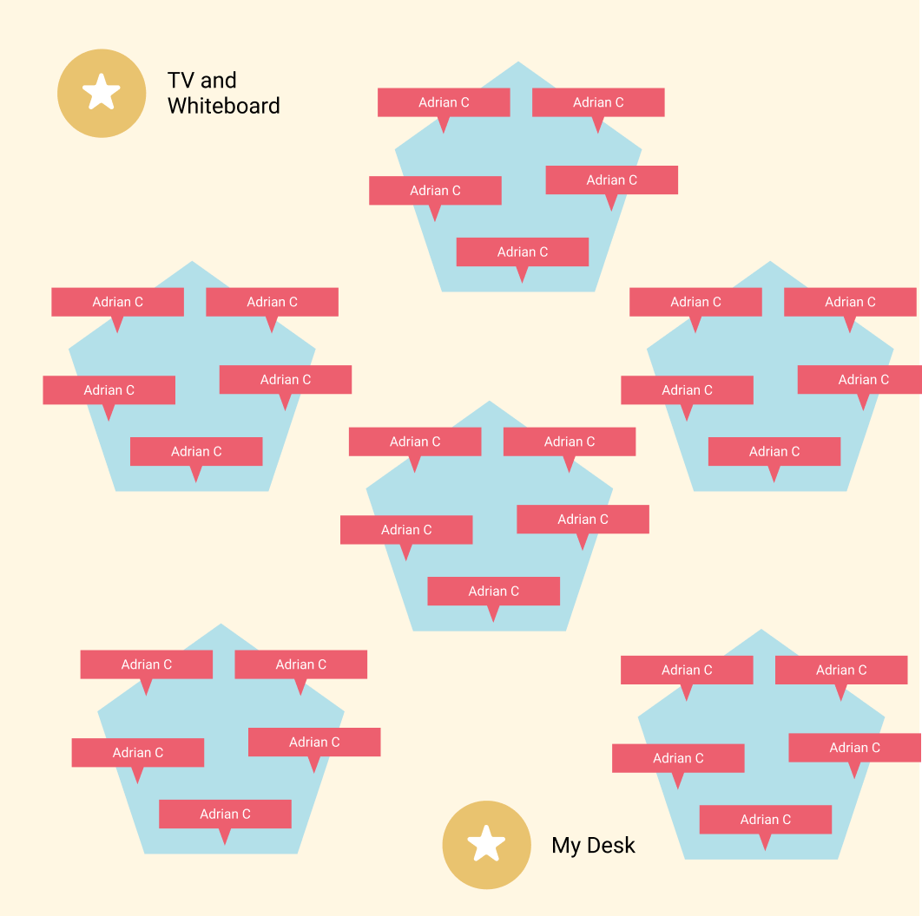

Prototype

Slide 24
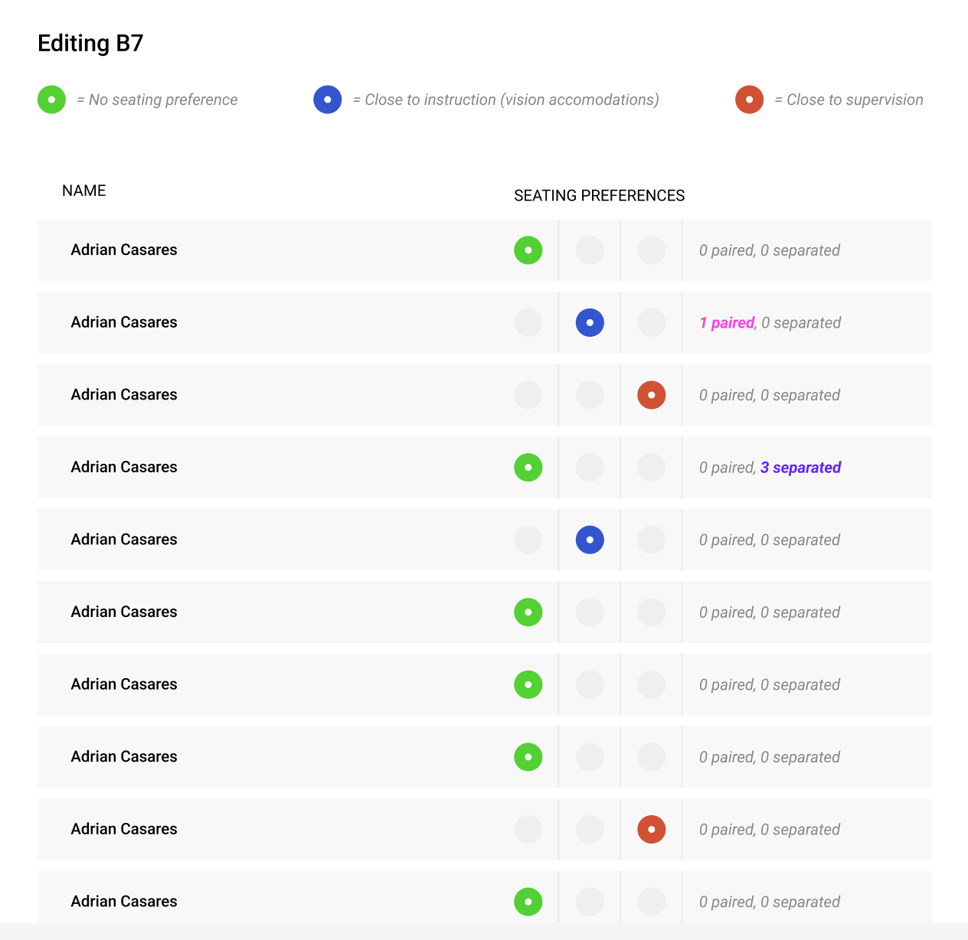
Prototype

Slide 25
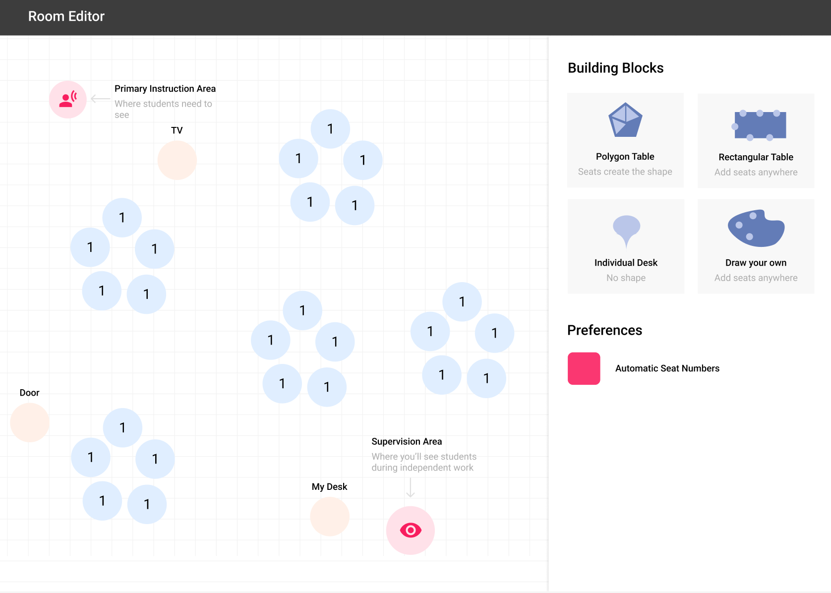
Prototype

Slide 26
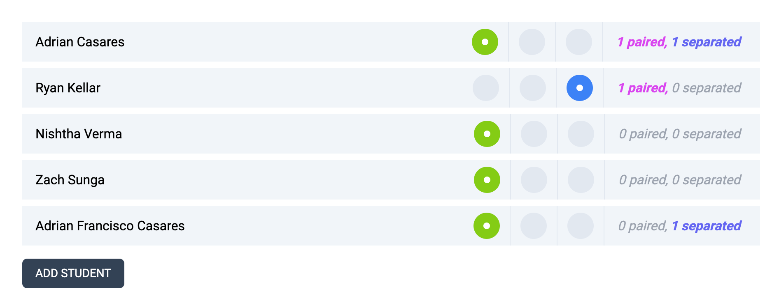
Test: Period Editor

Slide 27
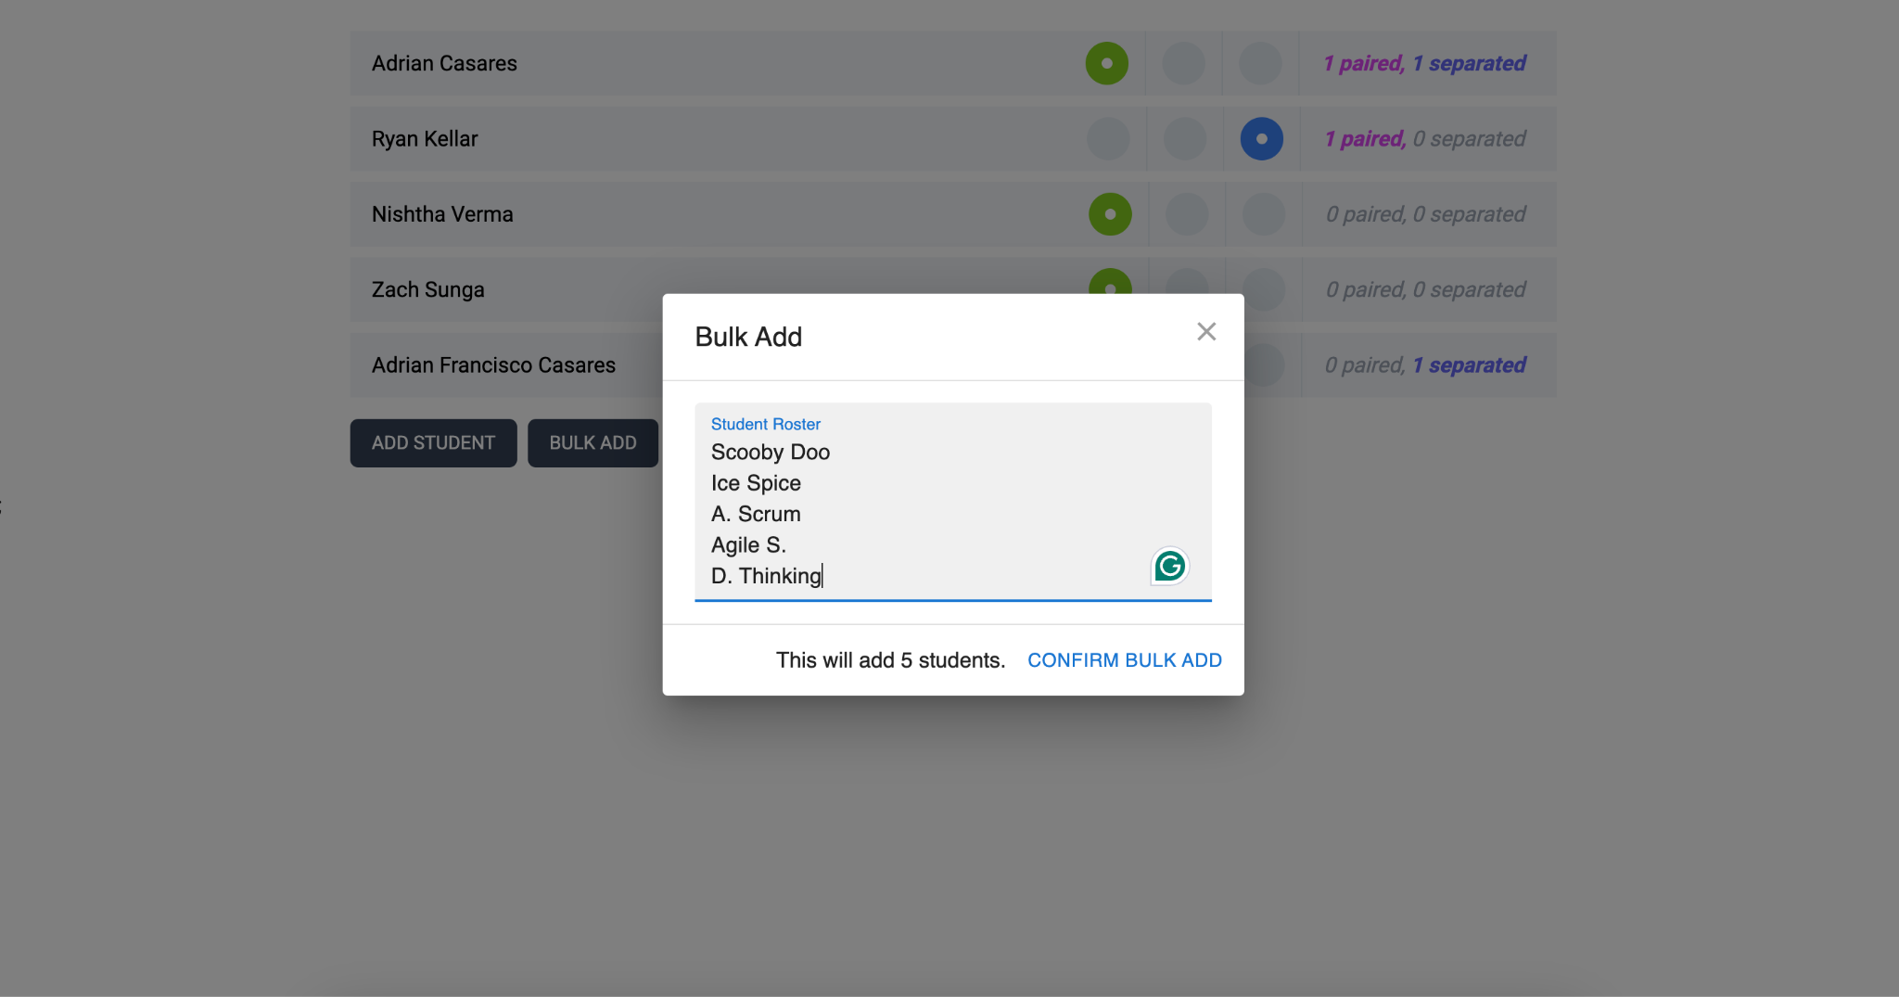
Test Conclusions: Period Editor

Slide 28
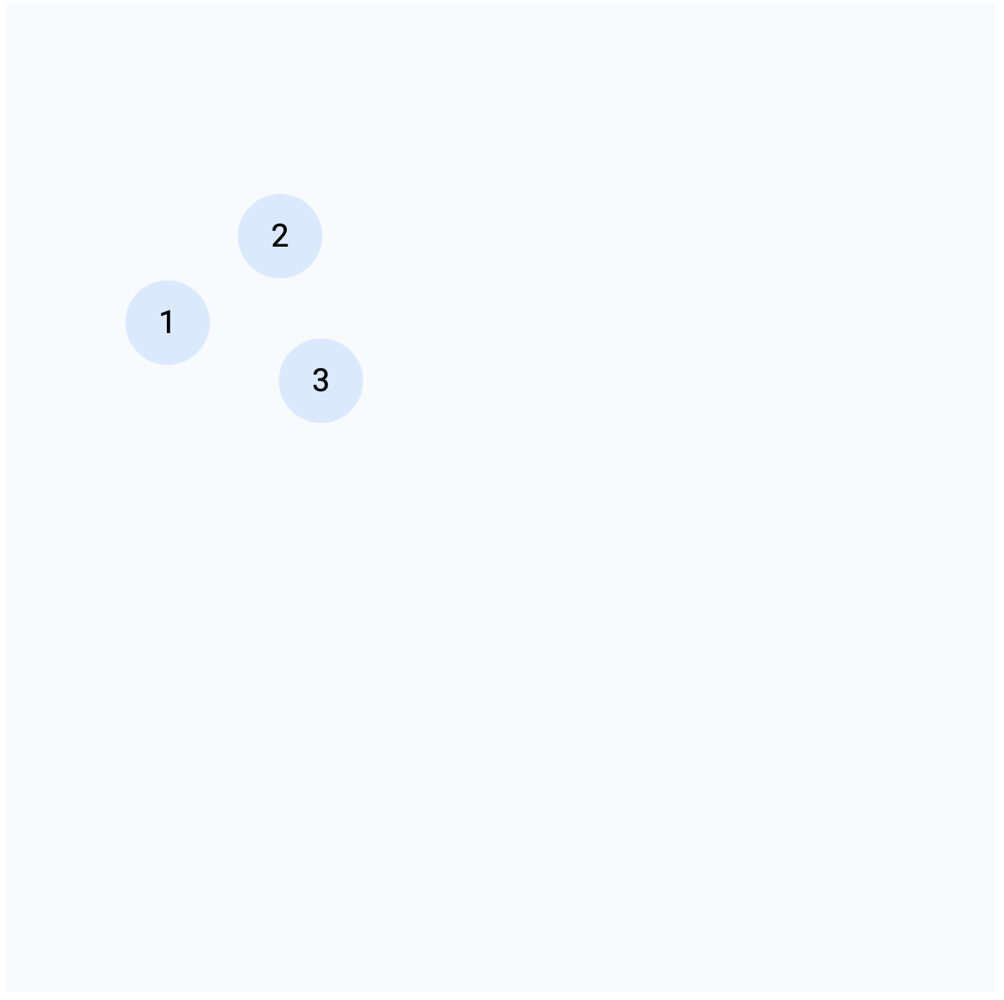
Test: Room Editor

Slide 29
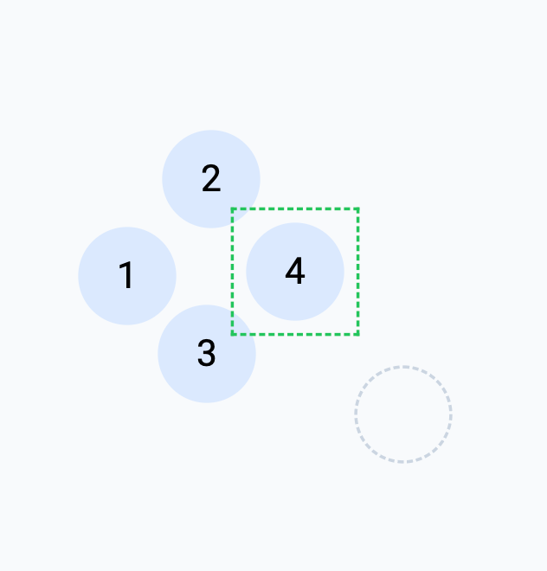
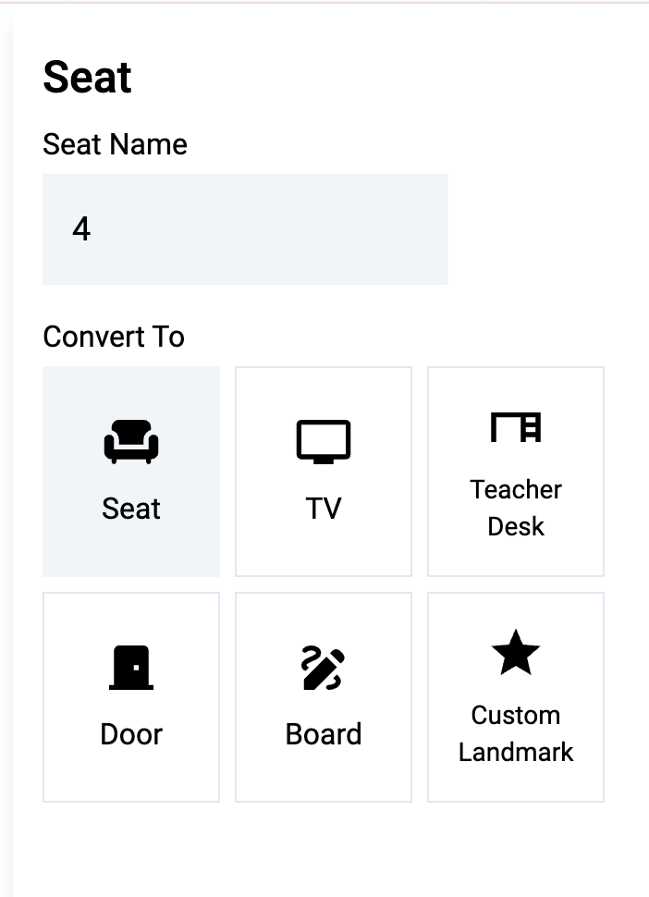
Accessibility

Slide 30
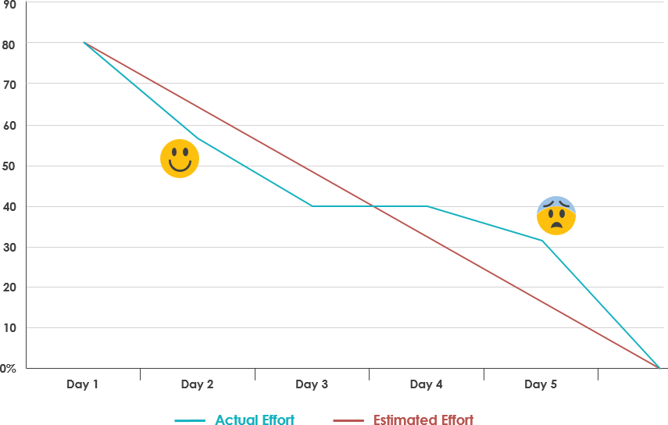
Retrospective
Number 1 challenge was figuring out what the workload would be
Notes:
Before we started sprint planning we didn’t expect it to take very long but once we planned our sprint we realized we needed to pace ourselves
we ended up having to make a lot of the components ourselves which took a long time and made the project a lot longer than expected

Slide 31
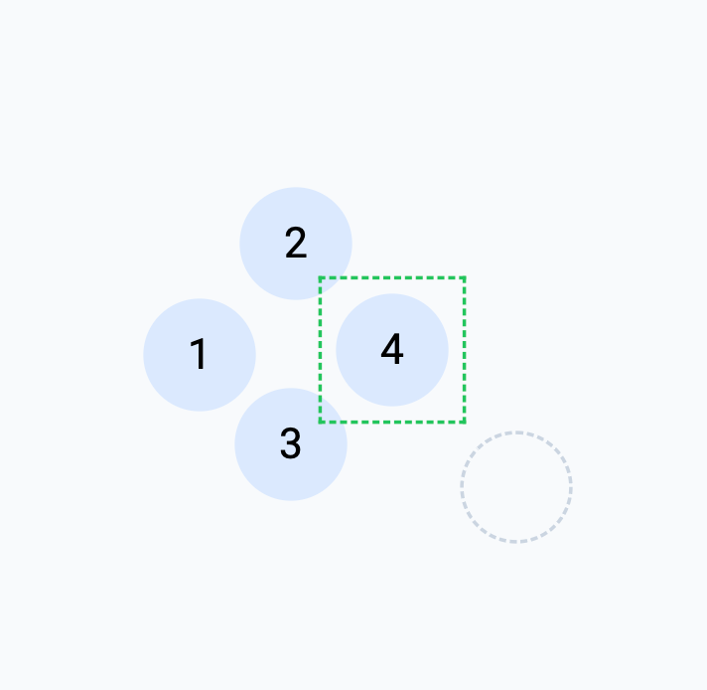
Custom Input Components
Dragging, dropping, selecting, boundaries, mouse movements, reference points, snapping
Notes:
Before we started sprint planning we didn’t expect it to take very long but once we planned our sprint we realized we needed to pace ourselves

Slide 32
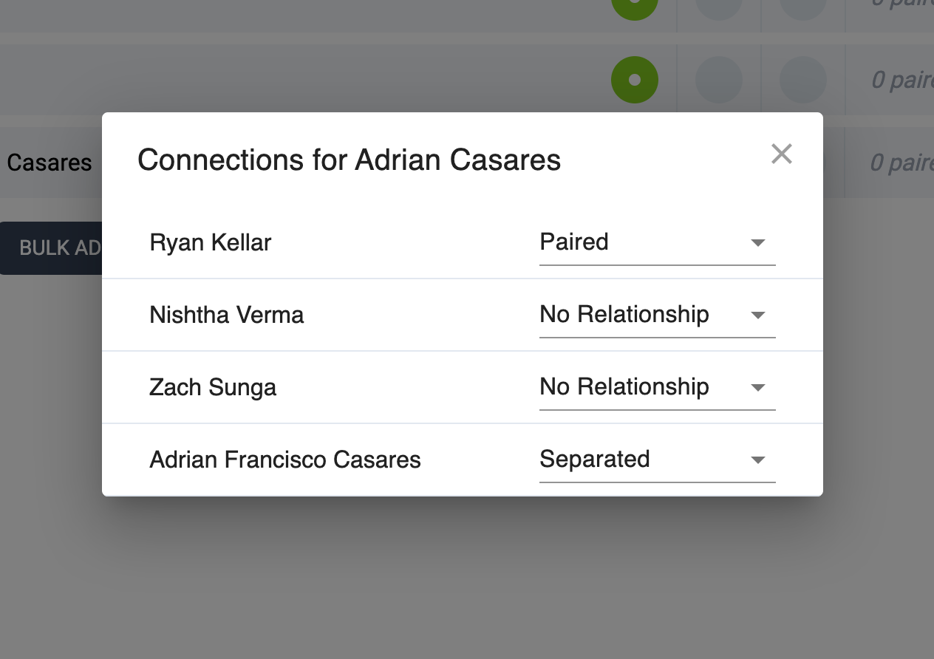
Custom Input Components
Notes:
Custom input components were another challenge for us because our main idea was to keep the tool simple but this ended up complicating the process by a lot.

Slide 33
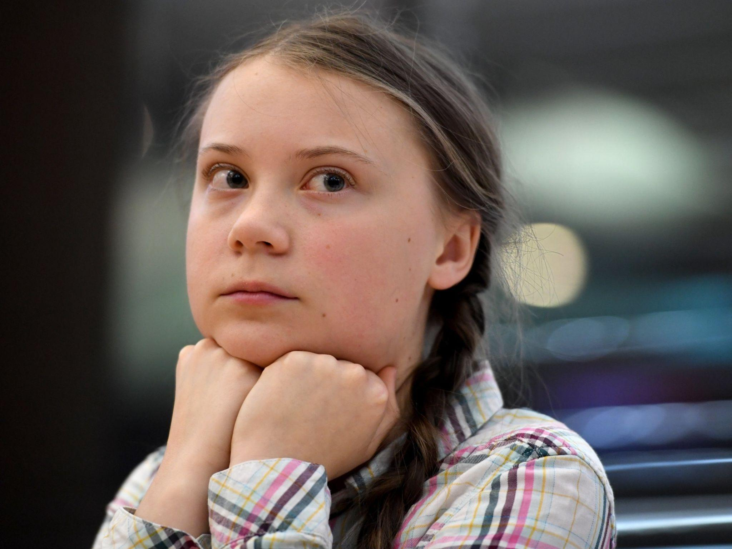
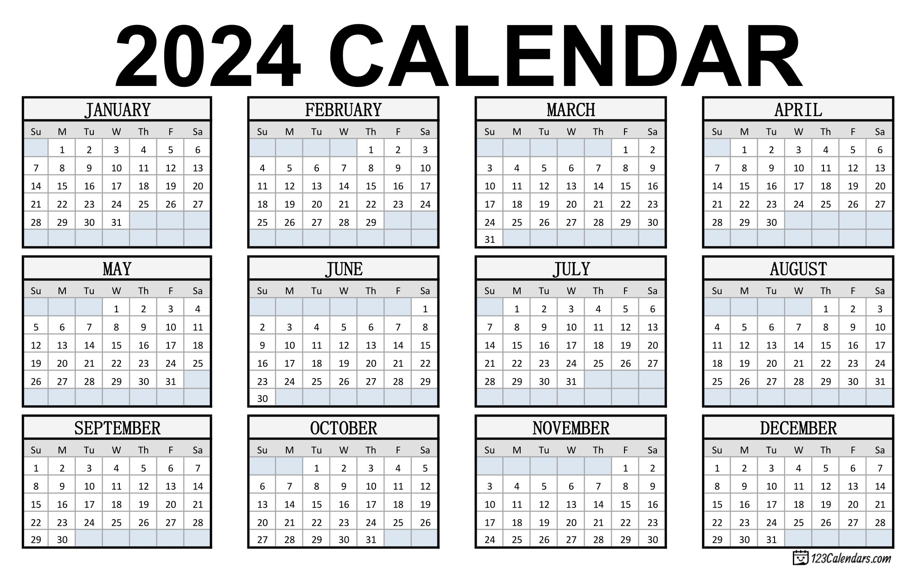
Retrospective
Number 2 challenge was figuring out the timing of finals week and the presentation, etc
Notes:
Before we started sprint planning we didn’t expect it to take very long but once we planned our sprint we realized we needed to pace ourselves

Slide 34
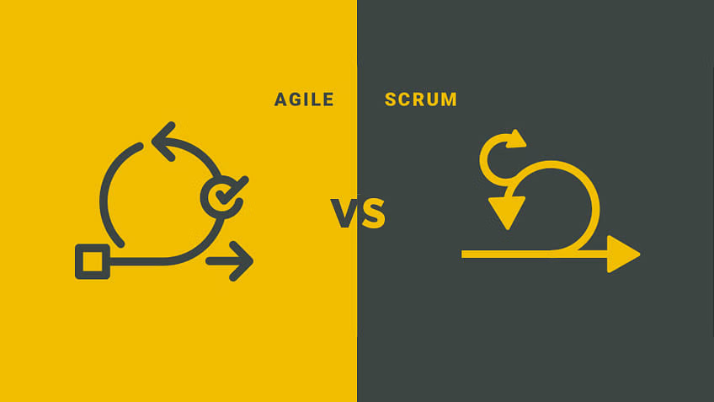
Retrospective
Number 3 challenge was how many absences there were because of AP classes
Notes:
Before we started sprint planning we didn’t expect it to take very long but once we planned our sprint we realized we needed to pace ourselves

Slide 35

Strategies that worked
Making a group chat
Sharing files and CCing on emails
Scheduling specific times to interview teachers
Interviewing shared teachers
Notes:
Before we started sprint planning we didn’t expect it to take very long but once we planned our sprint we realized we needed to pace ourselves

Slide 36

Strategies that didn’t work
Meeting during class (too unpredictable)
Notes:
Before we started sprint planning we didn’t expect it to take very long but once we planned our sprint we realized we needed to pace ourselves

Slide 37
Planning Next Steps
Steps to achieve MVP:
Seating algorithm last steps (framework already in place)
Saving seating charts (might need to adjust database format)
Display finalized seating charts
Other steps
Bulk Add Tool

Slide 38
Stuff We’ve Already Finished
Student Rosters
Choosing their seating type
Adding a name
Customizing connections between students
Room Editor
Drag and Drop feel
Landmarks, custom seat labels
Accessibility

Slide 39
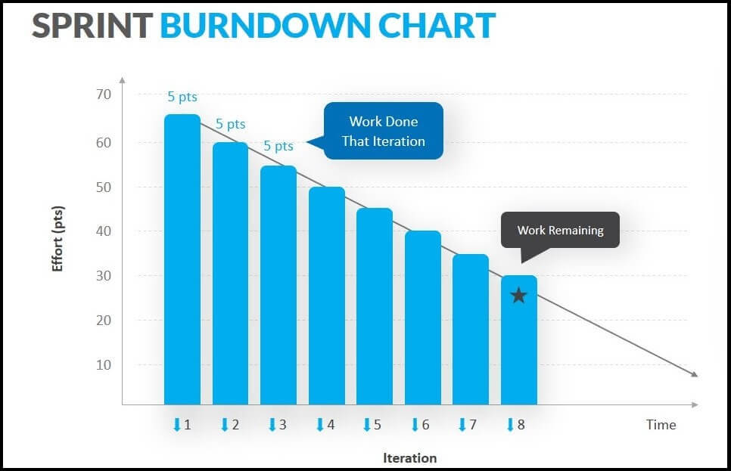
Burn Down Trends
Would take about 2 weeks
Fairly linear
Agile scrum

Slide 40
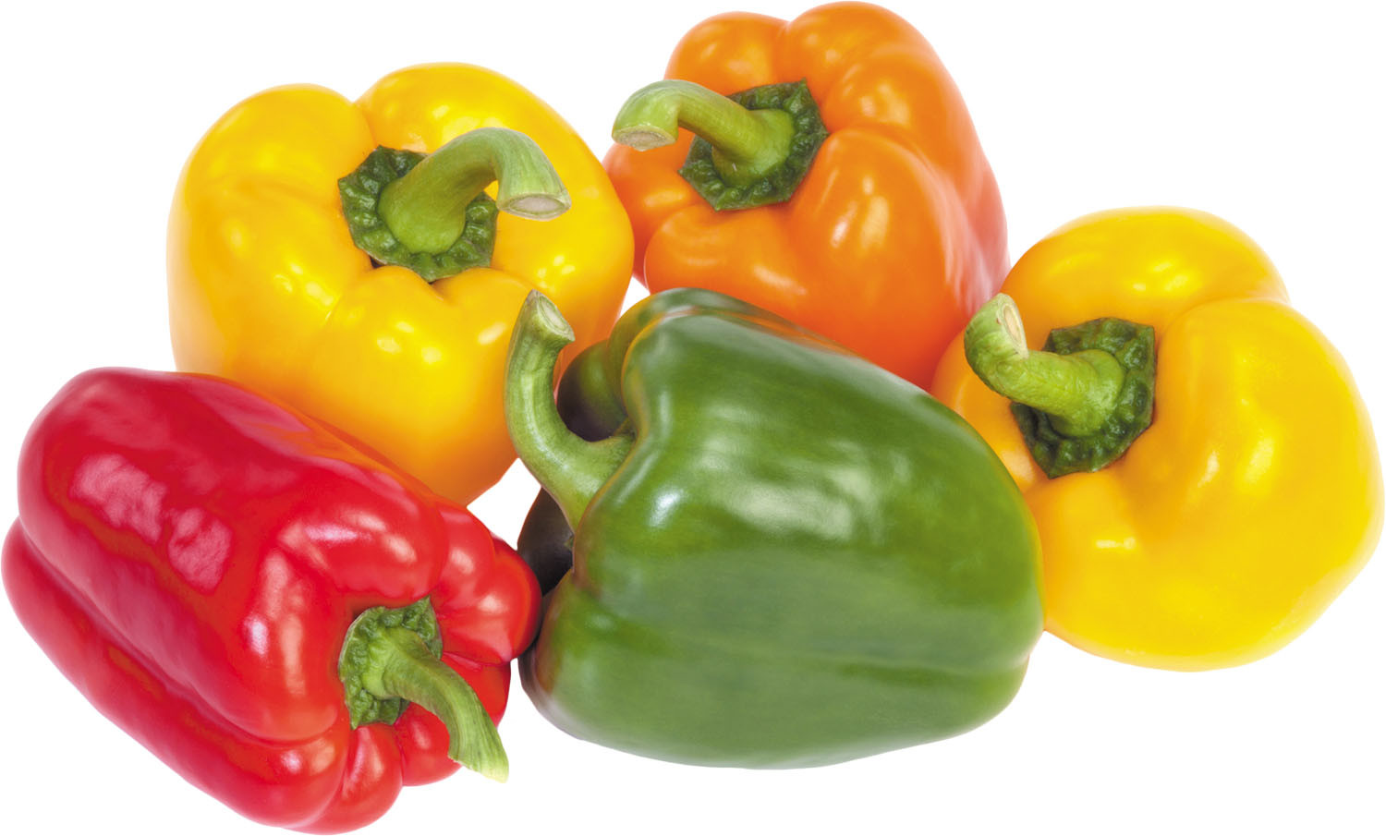
Joke

